Slide 1

An Analysis of HBCUs By: Jai Jacobs

Slide 2
Table on Contents
Brief History of HBCUs
Summary Data of All Institutions
HBCU Types
All
Land-Grant
Public
Private
Enrollment
Admissions
Graduation Rates
Graduation & Transfer Rates
Pricing
Pell Grants & Federal Loans

Slide 3

HBCUs: History
Originally, Historically Black Colleges and Universities (HBCUs) were Black Americans’ only recourse for education
The first established HBCU was Cheyney University of Pennsylvania in 1837
A majority of HBCUs were established after 1865, at the conclusion of the US Civil War
Most HBCUs were founded in Southern states
Source: https://hbcufirst.com/resources/hbcu-history-timeline
Notes:
In Title III of the Higher Education Act of 1965, Congress officially defined an HBCU as a school of higher learning that was accredited and established before 1964, and whose principal mission was the education of African Americans.
https://www.tmcf.org/about-us/member-schools/about-hbcus/#:~:text=In%20Title%20III%20of%20the,the%20education%20of%20African%20Americans.

Slide 4
HBCUs: Summary Data
For the academic year 2021-2022
101
HBCUs are in existence
21
Different US states, district, and US territory house HBCUs
249,244
Number of enrolled undergraduates across all HBCUs
48,494
Number of Associate, Bachelor, Master, and Doctorate degrees issued across all HBCUs
Source: https://nces.ed.gov/ipeds/datacenter/InstitutionList.aspx?goToReportId=1&sid=1214ca4d-d341-4739-af2b-bb571778daae&rtid=1

Slide 5
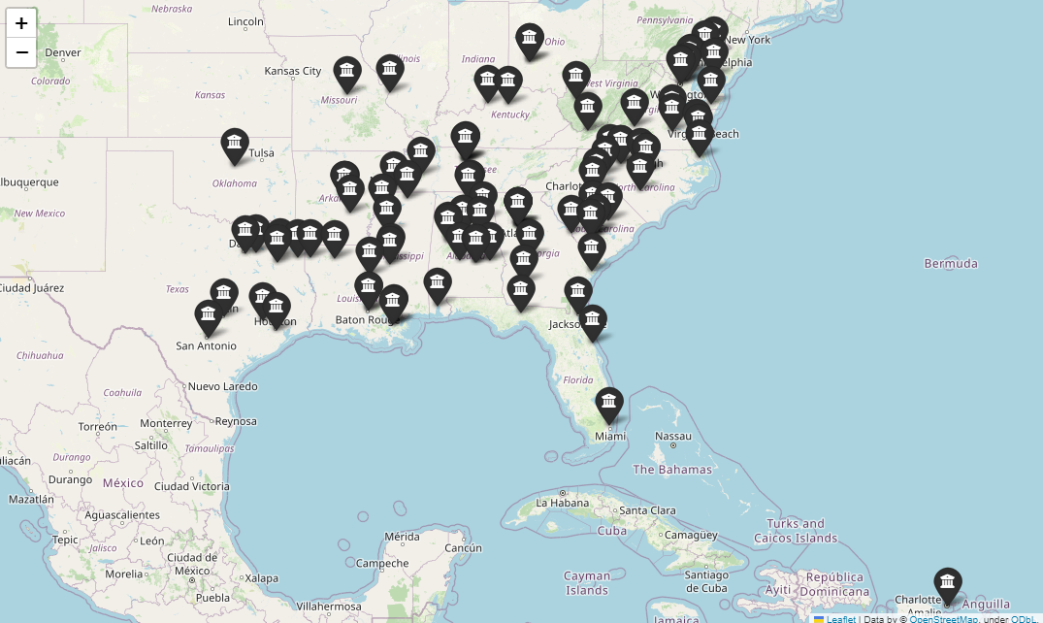
All HBCUs
HBCUs
All Institutions
101
Source: https://nces.ed.gov/ipeds/datacenter/InstitutionList.aspx?goToReportId=1&sid=1214ca4d-d341-4739-af2b-bb571778daae&rtid=1

Slide 6
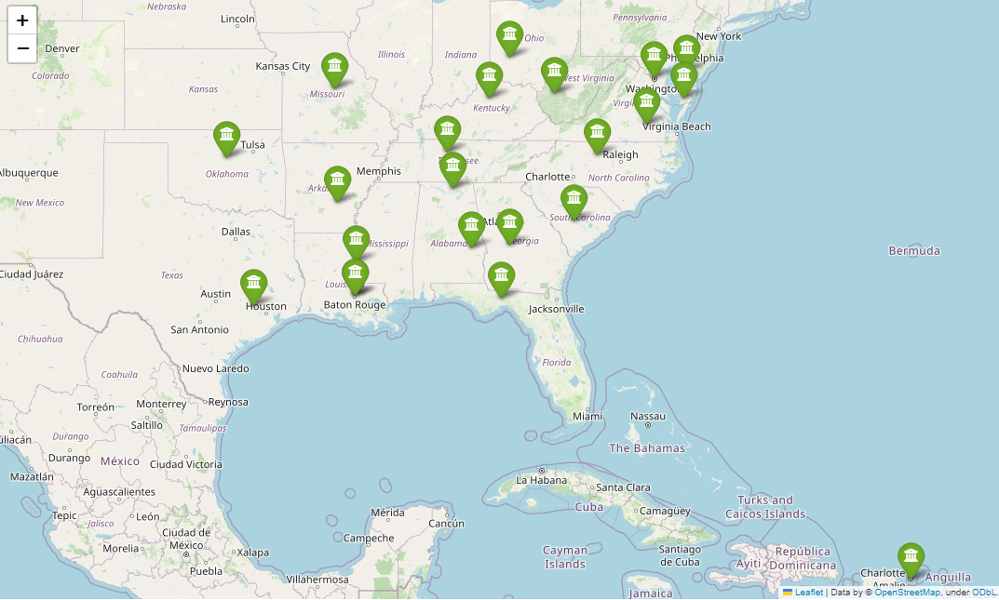
Land-Grant HBCUs
Land Grant HBCUs
4-year institutions
2-year institutions
22
0
Source: https://nces.ed.gov/ipeds/datacenter/InstitutionList.aspx?goToReportId=1&sid=1214ca4d-d341-4739-af2b-bb571778daae&rtid=1
Notes:
A land-grant college or university is an institution that has been designated by its state legislature or Congress to receive the benefits of the Morrill Acts of 1862 and 1890, or the Equity in Educational Land-Grant Status Act of 1994.
https://www.aplu.org/about-us/history-of-aplu/what-is-a-land-grant-university/#:~:text=A%20land%2Dgrant%20college%20or,Grant%20Status%20Act%20of%201994.

Slide 7
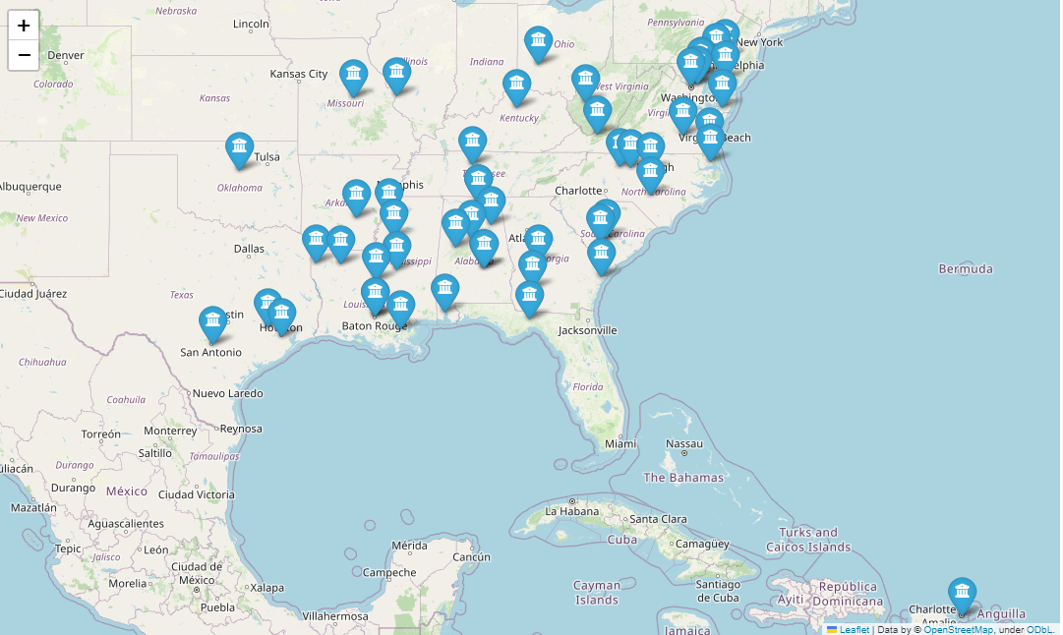
Public HBCUs
Public HBCUs
4-year institutions
2-year institutions
40
11
Source: https://nces.ed.gov/ipeds/datacenter/InstitutionList.aspx?goToReportId=1&sid=1214ca4d-d341-4739-af2b-bb571778daae&rtid=1

Slide 8
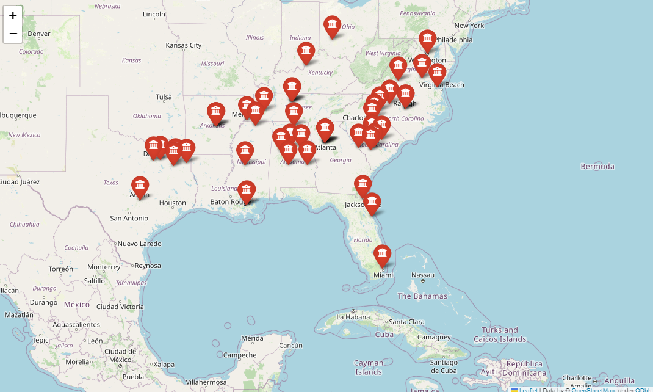
Private HBCUs
Private HBCUs
4-year institutions
2-year institutions
49
1
Source: https://nces.ed.gov/ipeds/datacenter/InstitutionList.aspx?goToReportId=1&sid=1214ca4d-d341-4739-af2b-bb571778daae&rtid=1

Slide 9
HBCUs: Enrollment
For the academic year 2021-2022
Average Overall Undergrad Enrollment Totals
Top Ten Enrollment: Public 4-Year HBCUs
North Carolina A&T State University
Prairie View A&M University College
Florida A&M University
Morgan State University
Tennessee State University
Central State University
North Carolina Central University
Southern University and A&M
Albany State University
Texas Southern University
Public 3926.65
Private 1154.67
Top Ten Enrollment: Private 4-Year HBCUs
Howard University
Clark Atlanta University
Hampton University
Xavier University of Louisiana
Morehouse College
Bethune-Cookman University
Spelman College
Tuskegee University
Benedict College
Claflin University
Source: https://nces.ed.gov/ipeds/datacenter/InstitutionList.aspx?goToReportId=1&sid=1214ca4d-d341-4739-af2b-bb571778daae&rtid=1

Slide 10
HBCUs: Admissions
For the academic year 2021-2022
Bottom Five Admissions: Public 4-Year HBCUs | Admissions Percent
Grambling State University | 31.0
Florida A&M University | 35.0
Alcorn State University | 39.0
Coppin State University | 48.0
North Carolina A&T State University | 57.0
Average Overall Admissions Percent: 73.97
Bottom Five Admissions: Private 4-Year HBCUs | Admissions Percent
Tuskegee University | 34.0
Howard University | 35.0
Rust College | 38.0
Wilberforce University | 39.0
Johnson C. Smith University | 45.0
Average Overall Admissions Percent: 64.87
Source: https://nces.ed.gov/ipeds/datacenter/InstitutionList.aspx?goToReportId=1&sid=1214ca4d-d341-4739-af2b-bb571778daae&rtid=1

Slide 11
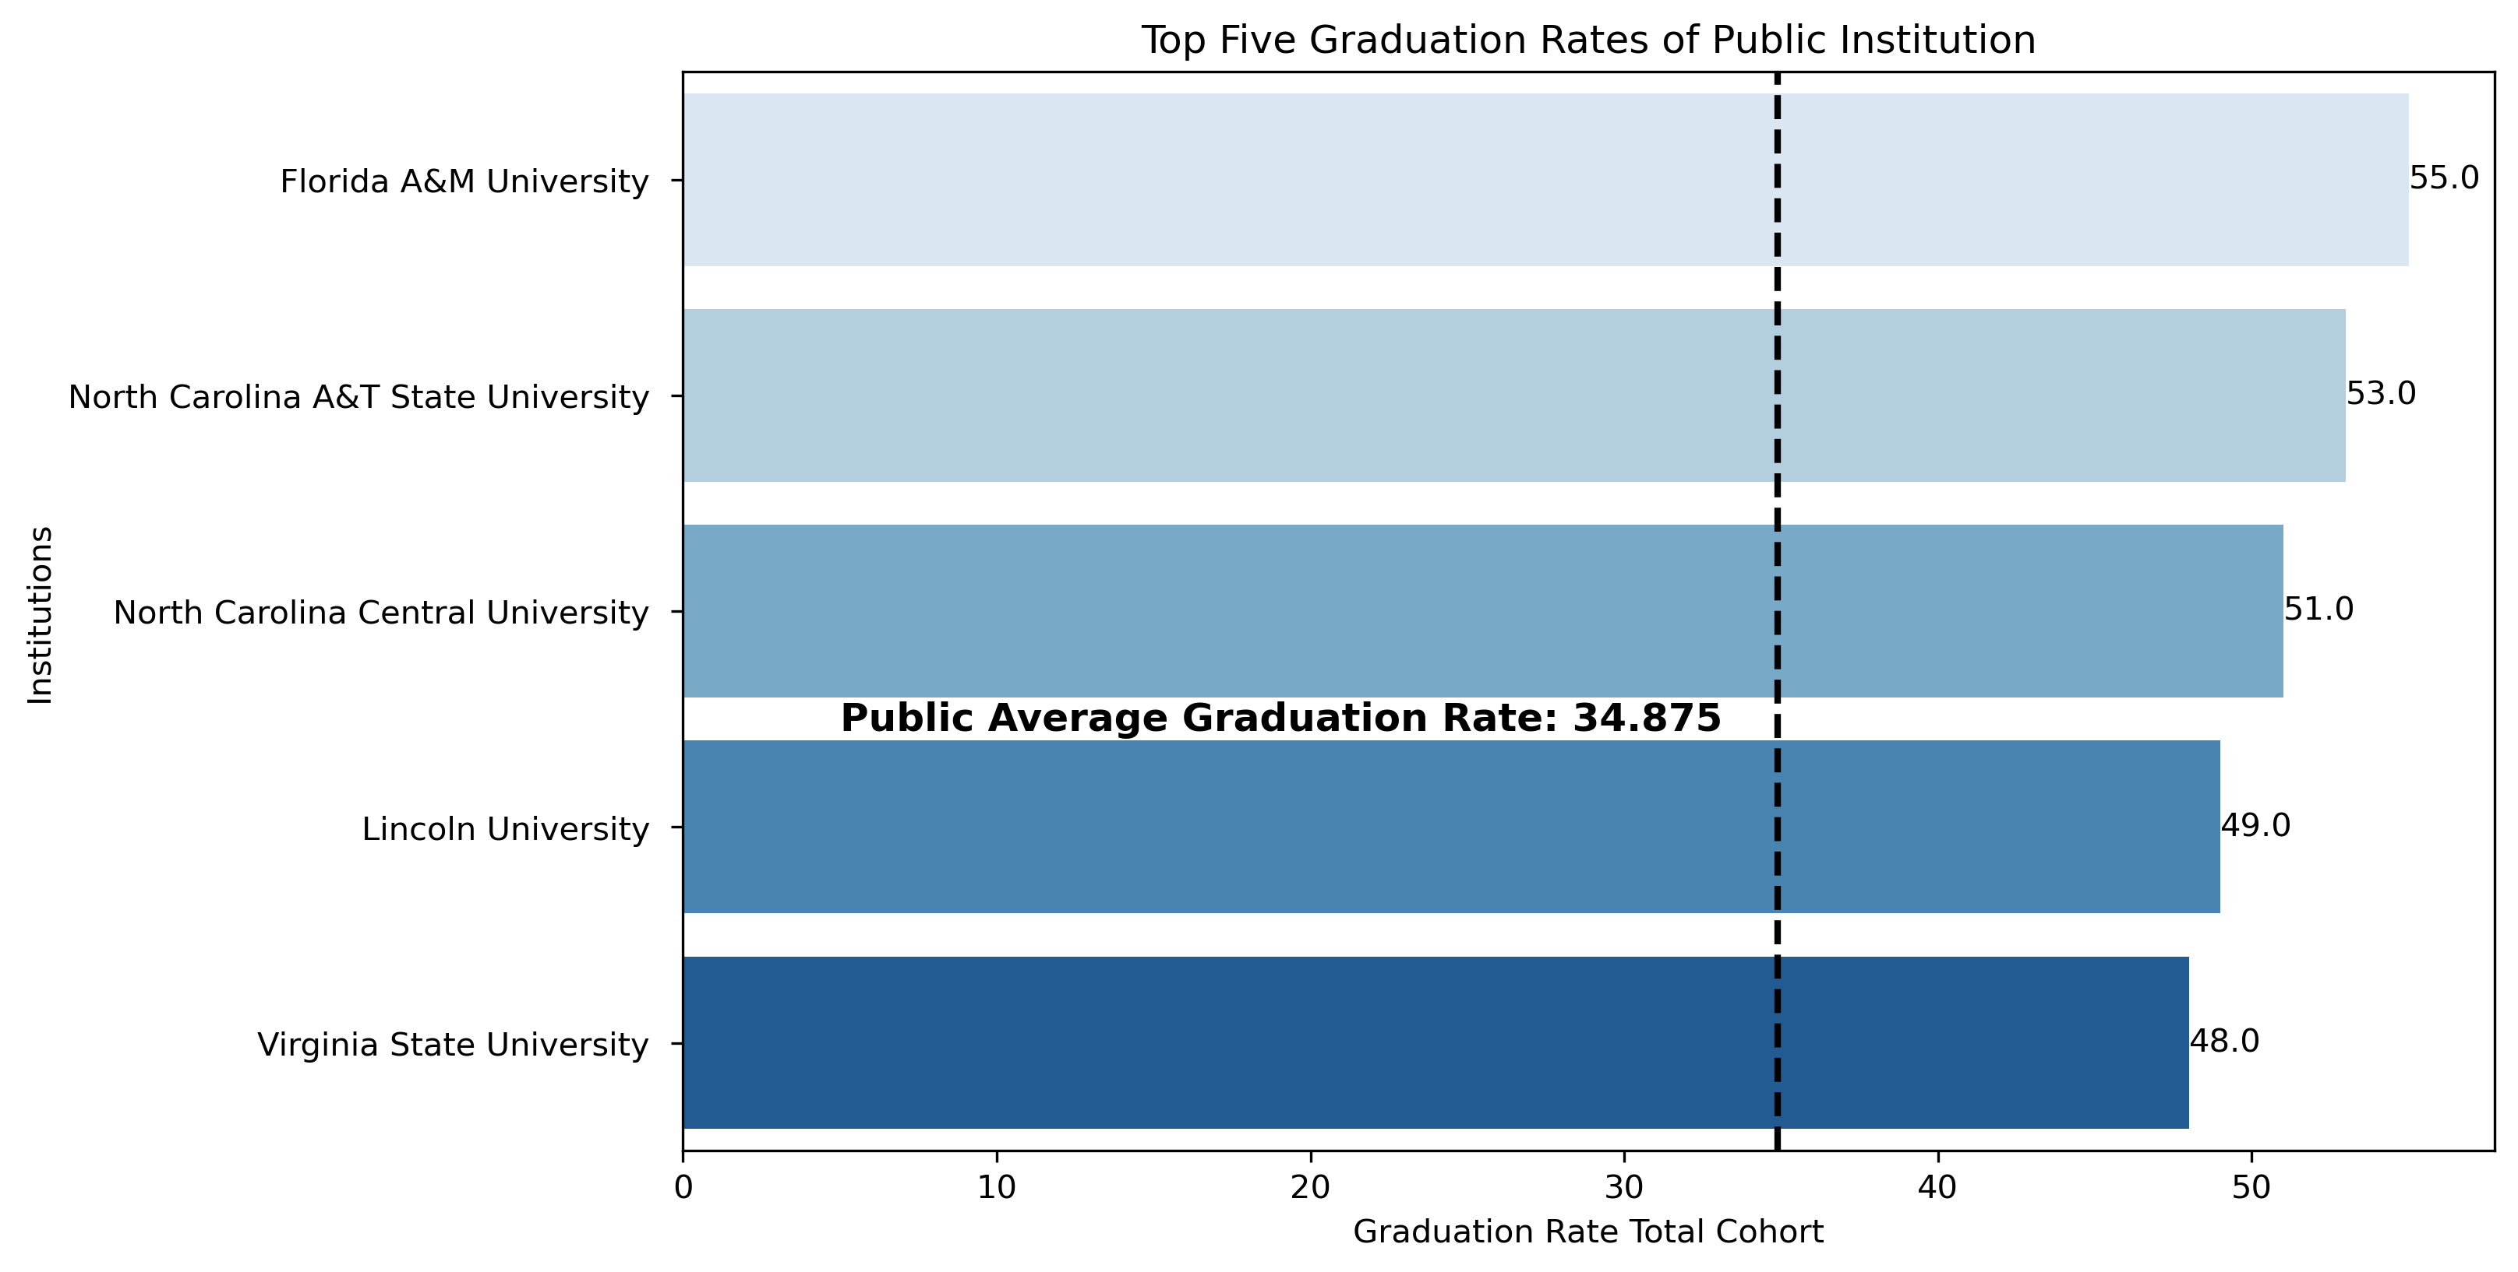
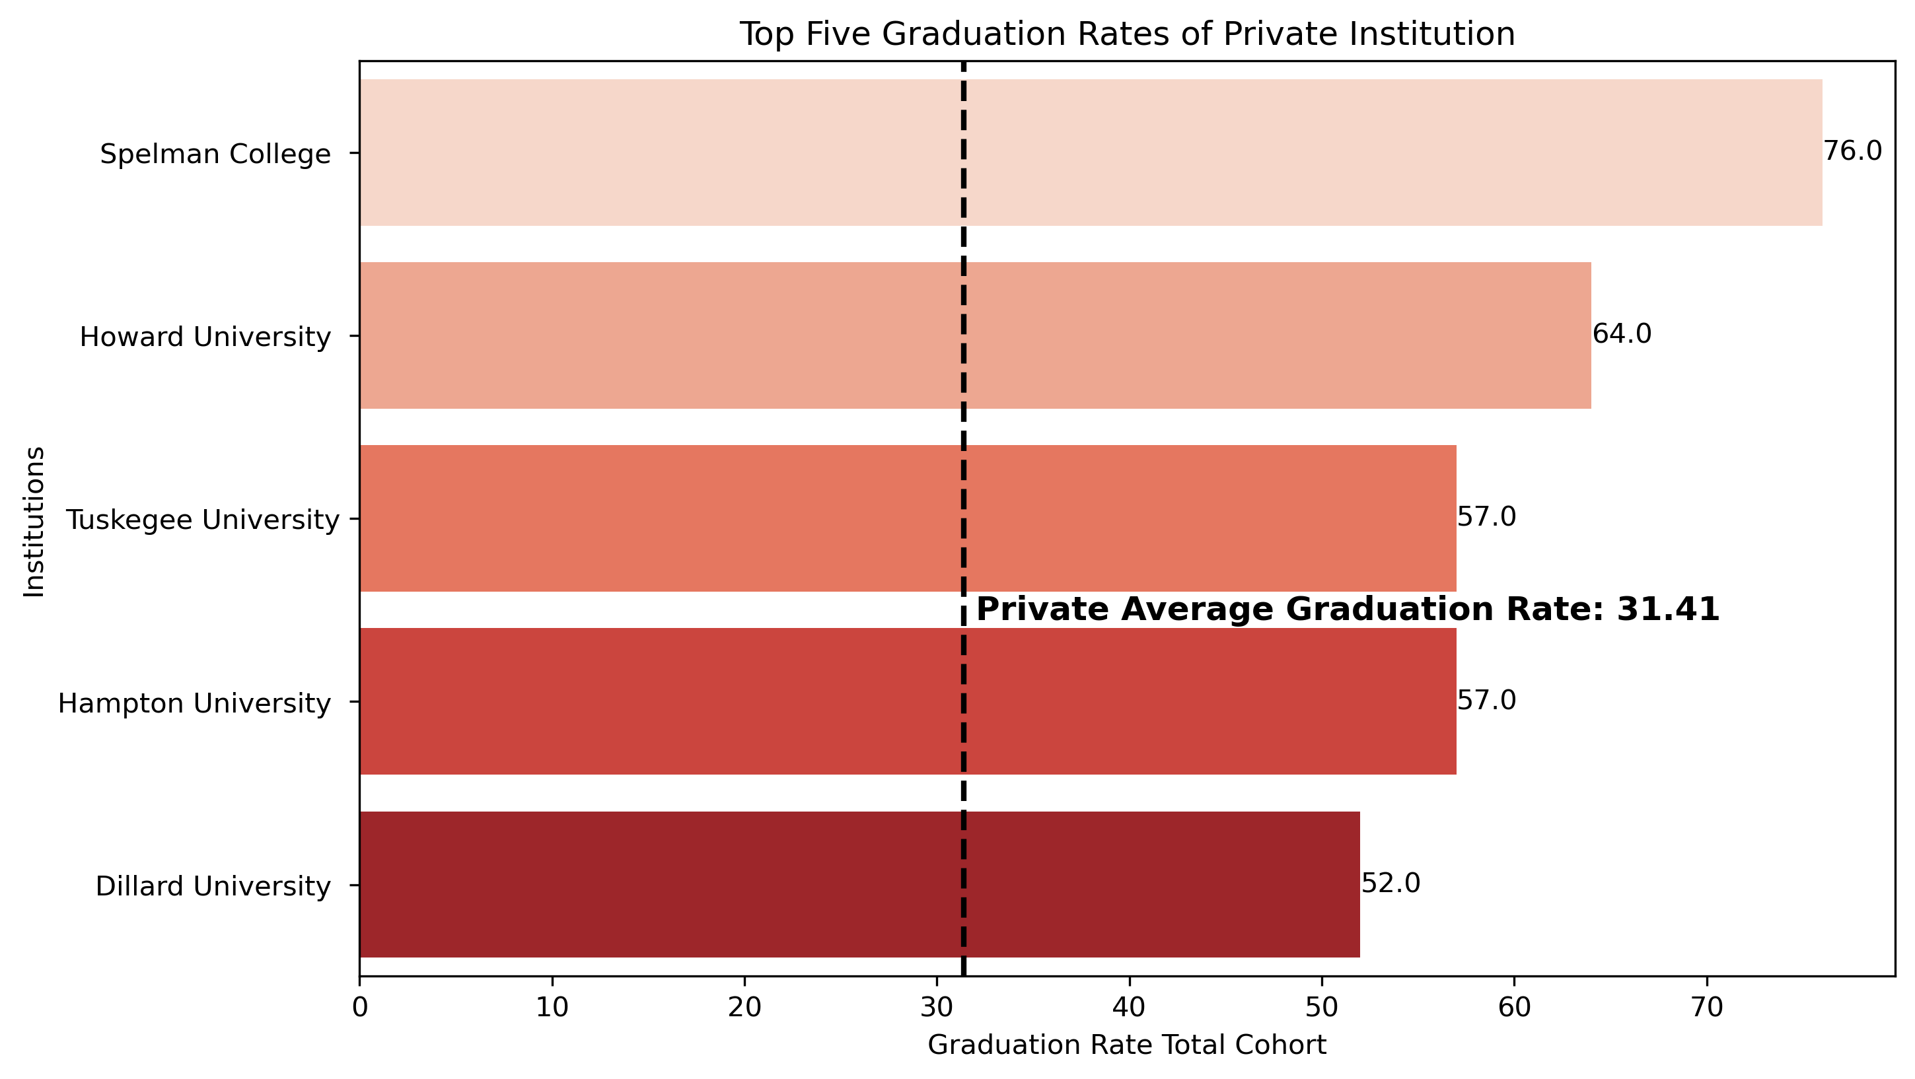
HBCUs: Graduation Rates
For the academic year 2021-2022
*4-Year HBCUs
Source: https://nces.ed.gov/ipeds/datacenter/InstitutionList.aspx?goToReportId=1&sid=1214ca4d-d341-4739-af2b-bb571778daae&rtid=1

Slide 12
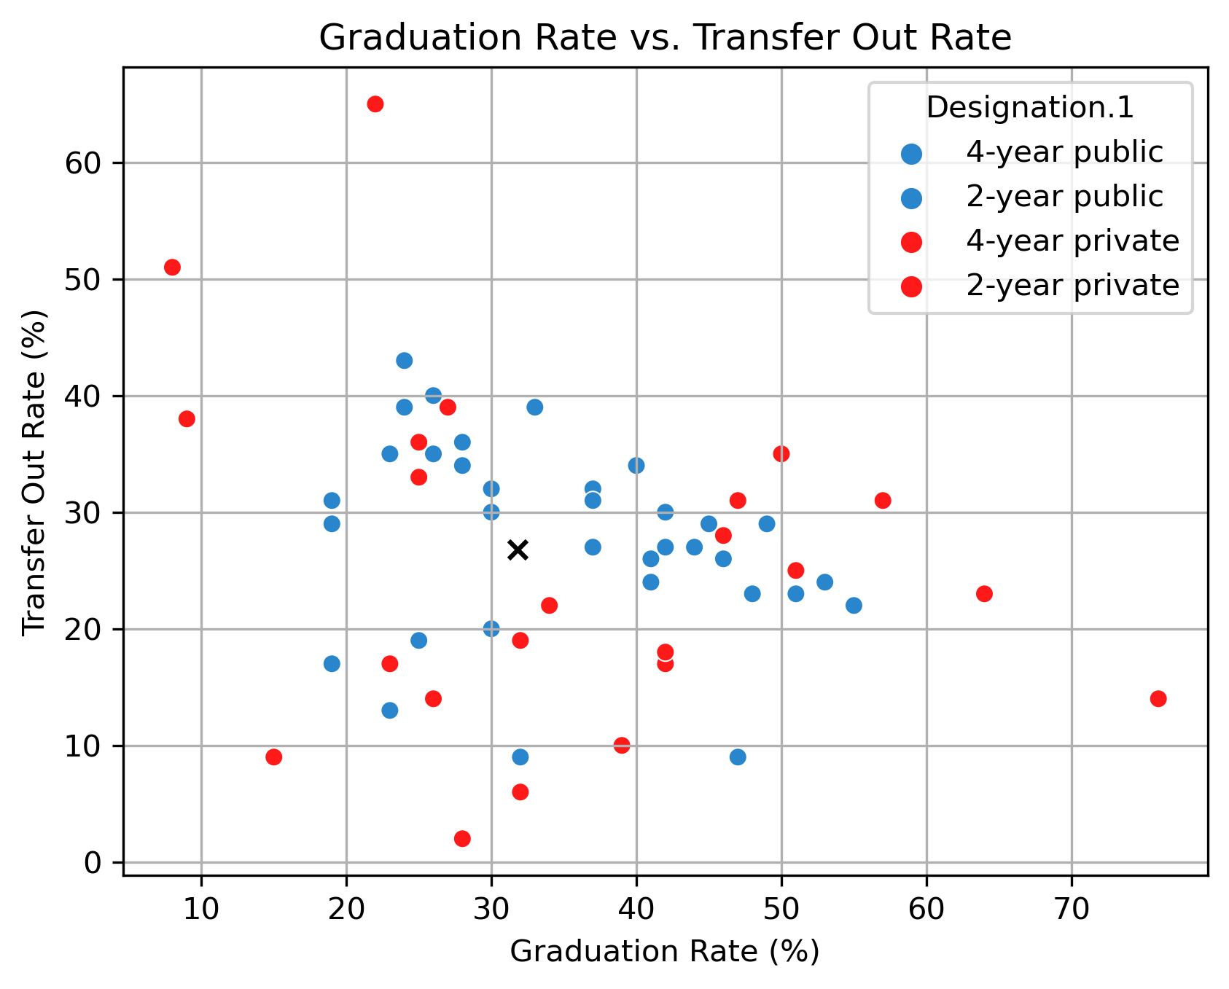
HBCUs: Graduation & Transfer Rates
For the academic year 2021-2022
Source: https://nces.ed.gov/ipeds/datacenter/InstitutionList.aspx?goToReportId=1&sid=1214ca4d-d341-4739-af2b-bb571778daae&rtid=1

Slide 13
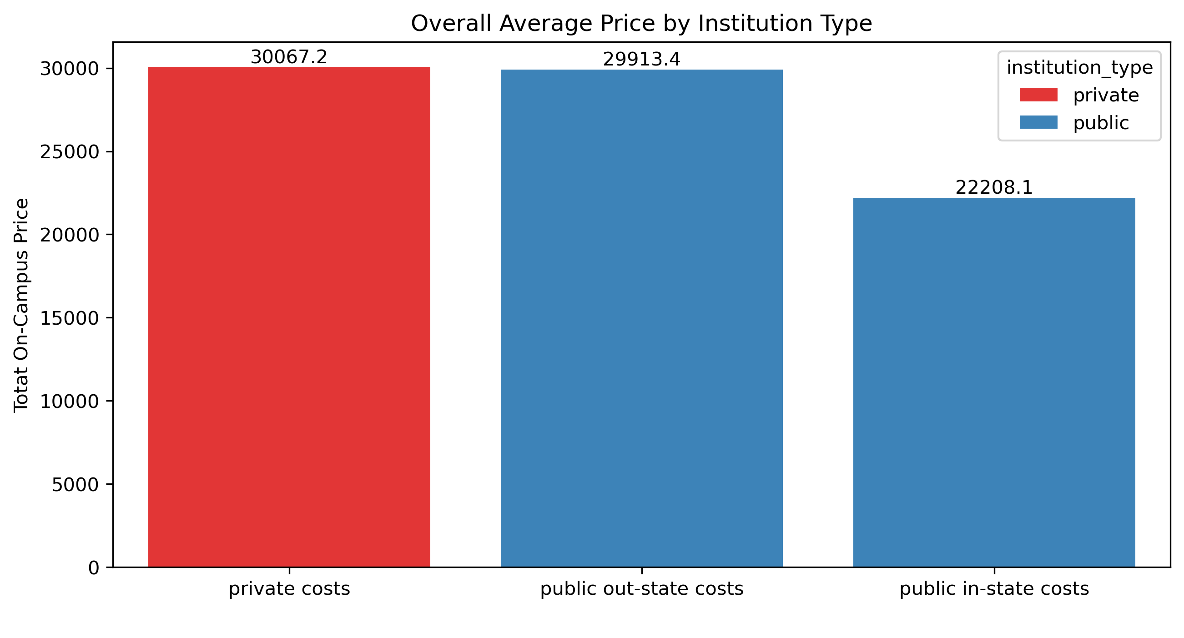
HBCUs: Pricing
For the academic year 2021-2022
Source: https://nces.ed.gov/ipeds/datacenter/InstitutionList.aspx?goToReportId=1&sid=1214ca4d-d341-4739-af2b-bb571778daae&rtid=1
Notes:
A Pell Grant is money the government provides for students who need to pay for college. Grants, unlike loans, do not have to be repaid. Eligible students receive a specified amount each year under this program.

Slide 14
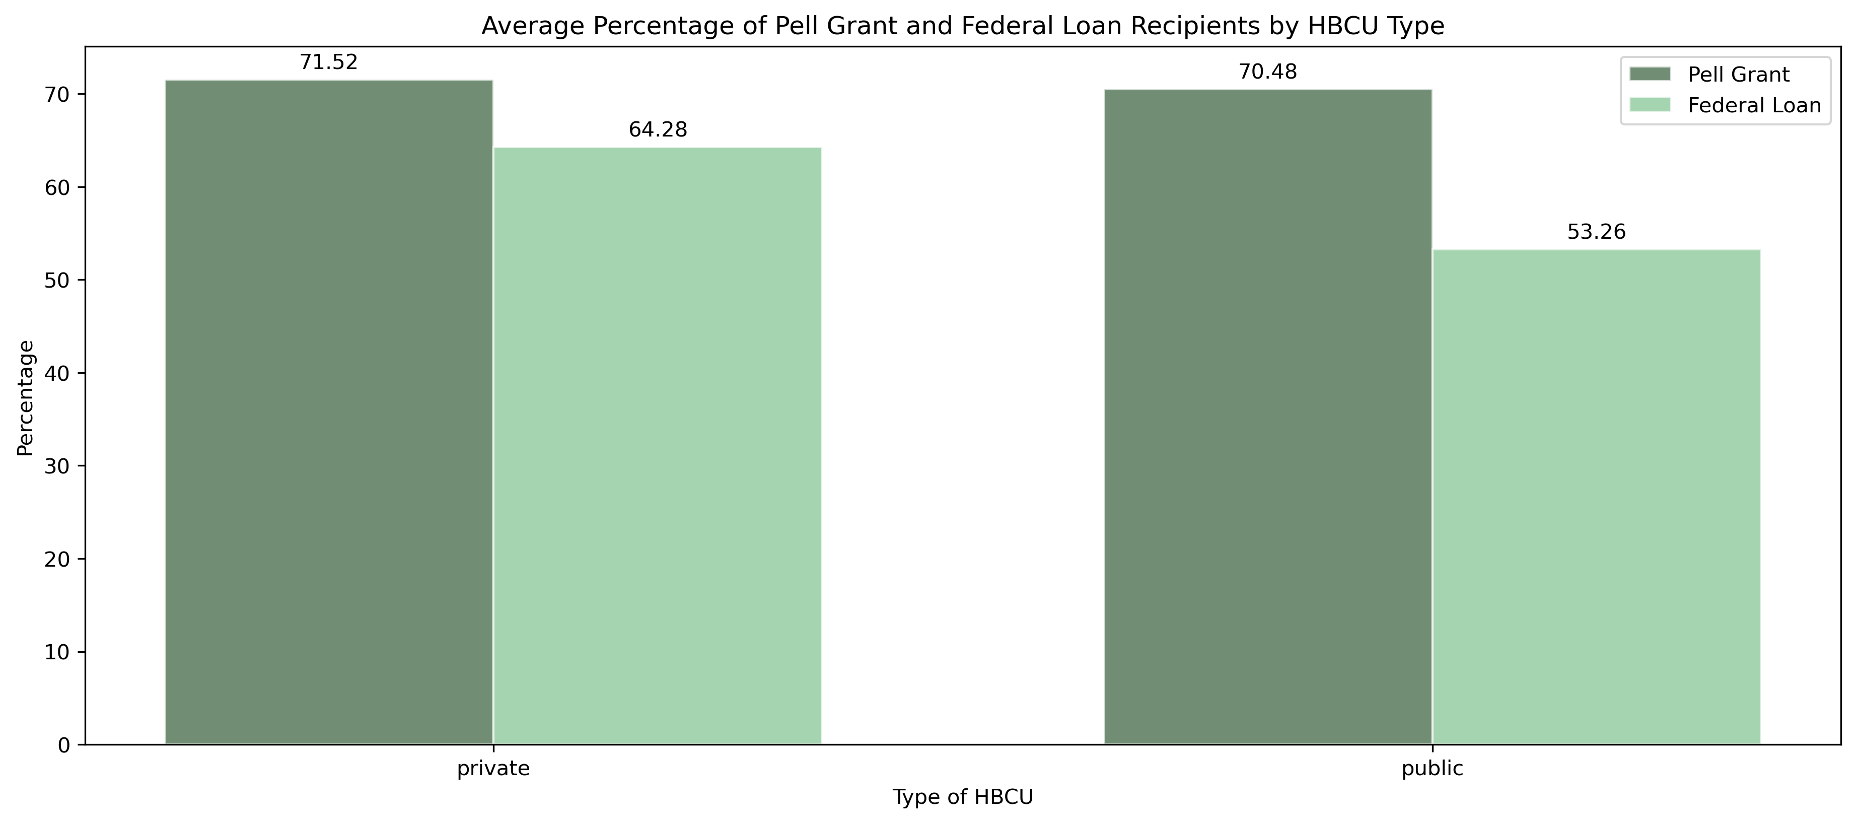
HBCUs: Pell Grants & Federal Loans
For the academic year 2021-2022
NASFAA.org states, “During the 2021-22 award year, Pell Grants ranged from $650 to $6,495”.
Source: https://nces.ed.gov/ipeds/datacenter/InstitutionList.aspx?goToReportId=1&sid=1214ca4d-d341-4739-af2b-bb571778daae&rtid=1

Slide 15
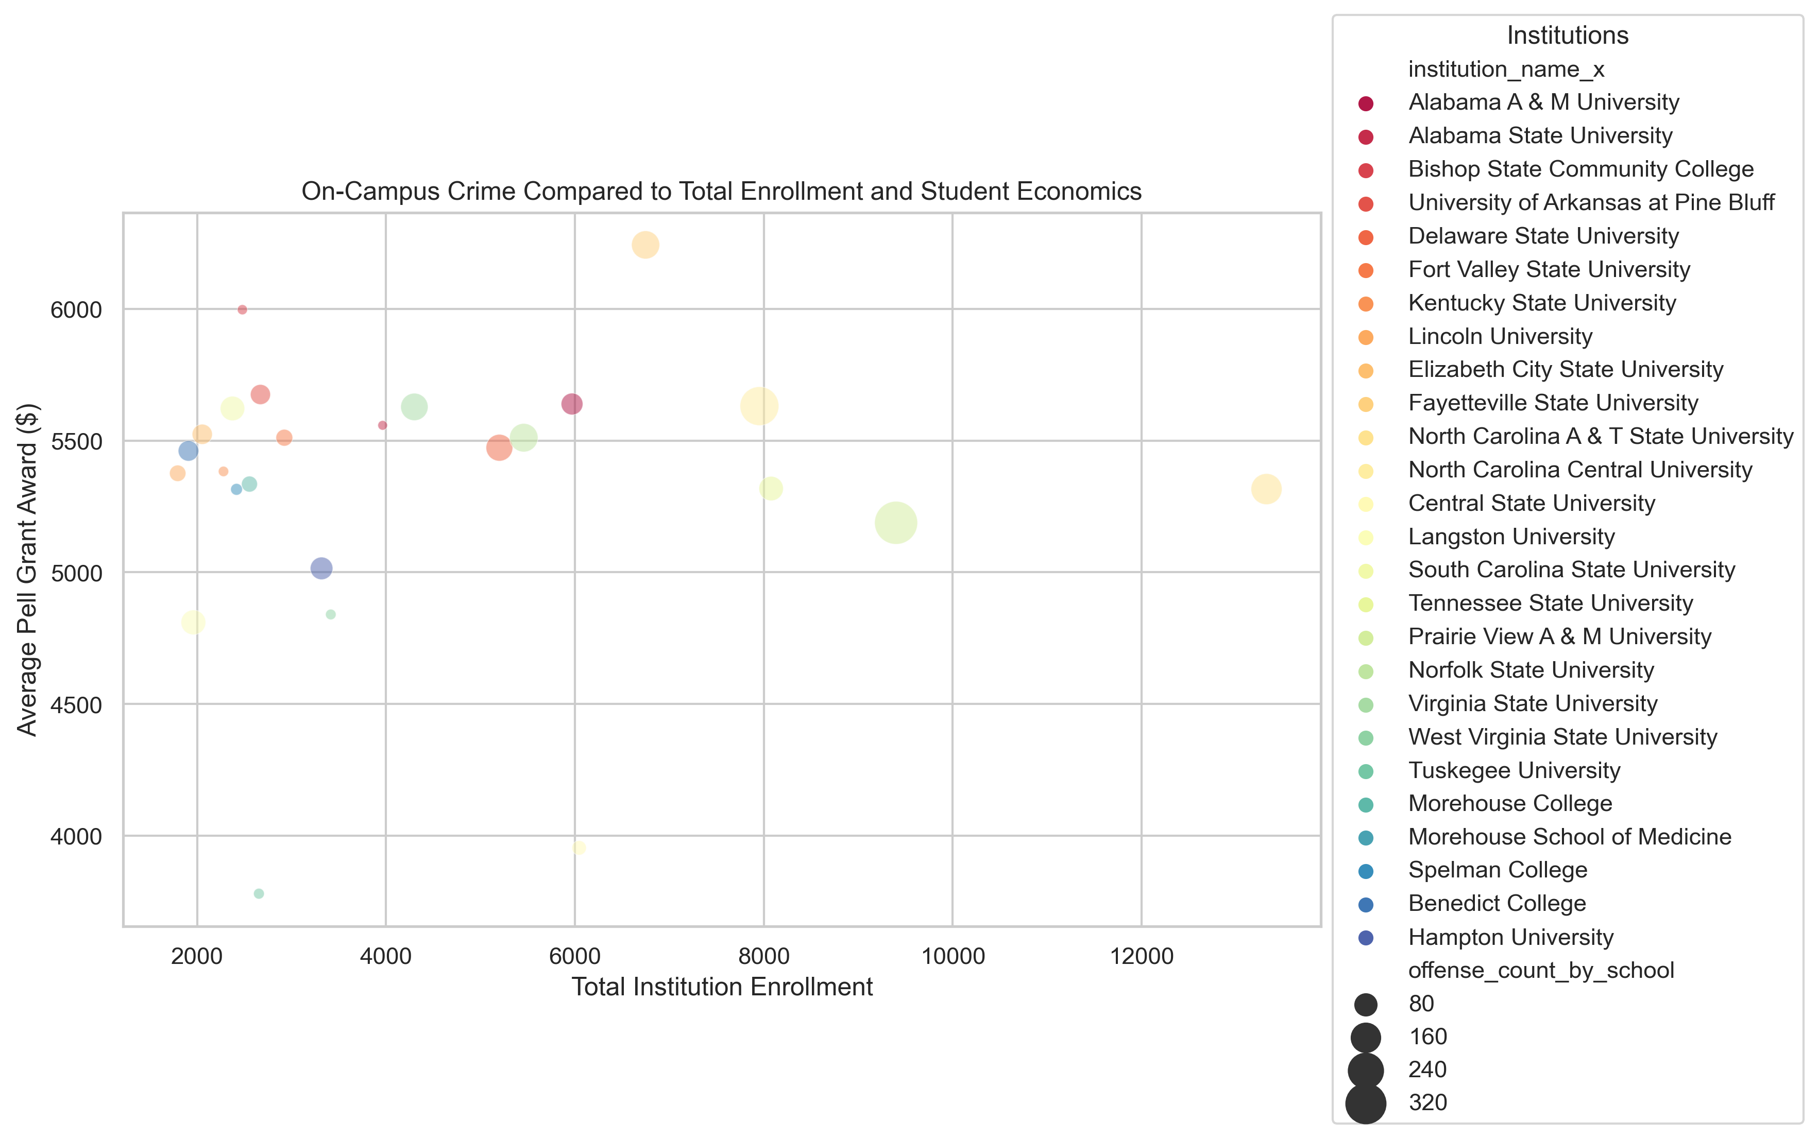
HBCUs: On-Campus Crime
For the academic year 2021-2022
*Crime Data: For the calendar year 2022
On-Campus Police Depts.
Public
Private
21
6
Total Crimes
2,462
Source: https://nces.ed.gov/ipeds/datacenter/InstitutionList.aspx?goToReportId=1&sid=1214ca4d-d341-4739-af2b-bb571778daae&rtid=1
Source: https://www.icpsr.umich.edu/web/NACJD/series/57?start=0&SERIESQ=57&ARCHIVE=NACJD&PUBLISH_STATUS=PUBLISHED&sort=TIMEPERIOD_SORT%20desc&rows=50&q=%3Dcounty

